Slide 1
TOPIC A4:
MACHINE LEARNING
LESSON A4-9
NEURAL NETWORKS

Slide 2
AGENDA
Warm up
Why a network
The perceptron
Hidden layers
Convolutional networks
The four settings
Choosing a model
Lab
WHAT U NEED 4 LESSON
Guided Notes
ur hedz

Slide 3
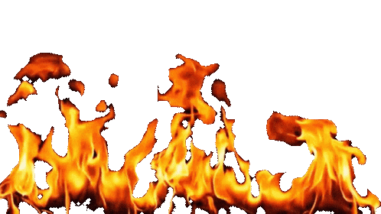
THE WARM UP QUESTION
(a) State what a clustering algorithm is given and what it produces [1]
(b) State what the reward is in a reinforcement learning system [1]
(c) A rule has a confidence of 0.80 and a lift of 1.00. State what the lift tells you [1]
→ Notes Q1 (a), (b), (c)

Slide 4
THE WARM UP ANSWER
(a) Unlabelled data in, a group number for every data point out
(b) Some value the environment gives the agent after it acts, such as the profit, the score, the time saved, etc
(c) The connection is meaningless because the second item was that common anyway, the rule is worthless.
Notes:
Quick. The drawing at step 3 is where the time needs to go.

Slide 5
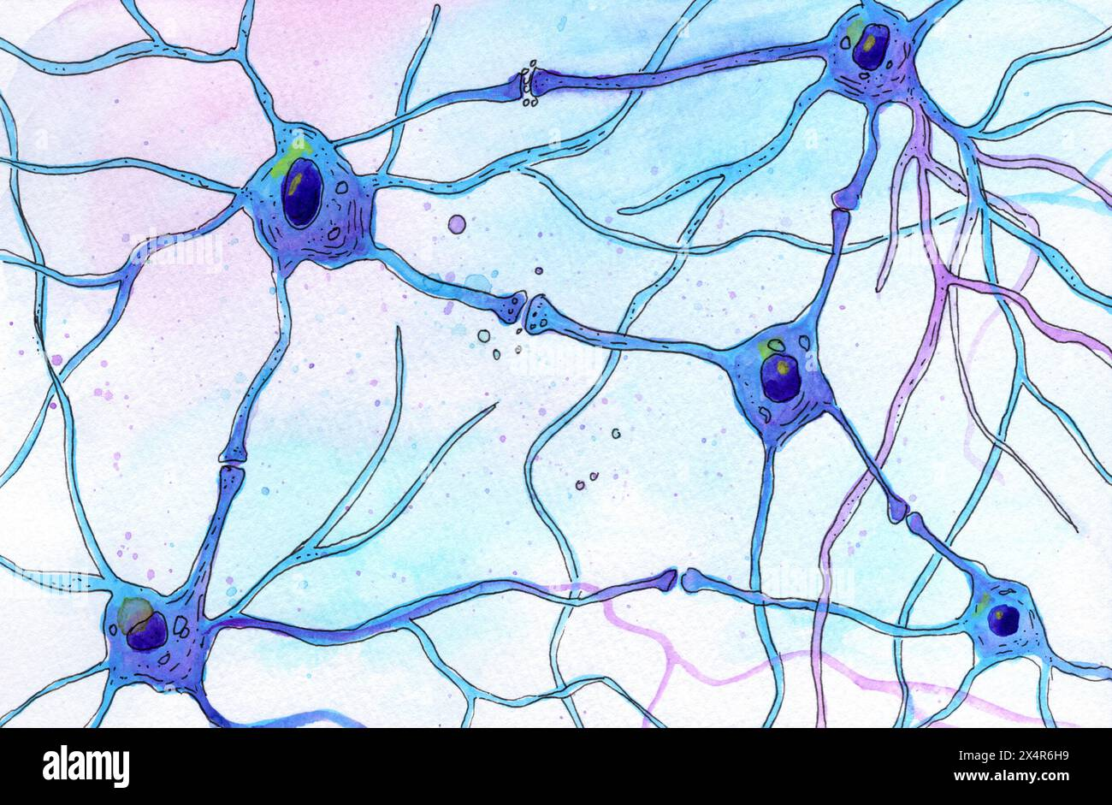
WHY A NETWORK
Linear regression from A4-5 draws one straight line through the data. That is its whole range
But of course, plenty of real world patterns are NOT straight lines
An artificial neural network is built from many small units, each doing something simple, wired together
  Like neurons in the brain!
They simulate interconnected nodes, or neurons, to process and learn from input data
They do classification, regression and pattern recognition, like we have, on more difficult data

Slide 6
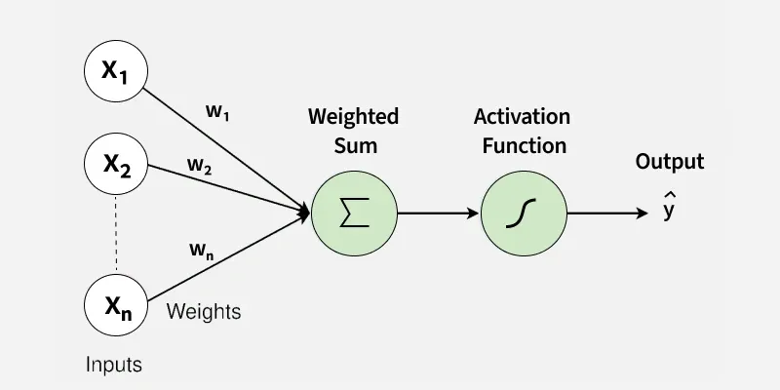
THE PERCEPTRON
A perceptron is the basic ‘unit’ here, it has five parts
Inputs - the feature values going in, one number each
Weights - one per each input
  The weight decides how much that input matters, and it can be negative
Bias – a constant value added to the weighted sum
Activation function – a function that takes the total and decides the output
  Ours will output 1 if the total is above zero, otherwise 0
Output – the number output by the activation function
b
bias
Notes:
Draw it on the board as they draw it on the sheet. Label as you go.

Slide 7
THE PERCEPTRON
Let’s assume a spam detector with three inputs. Each is 1 for yes and 0 for no.
Contains the word “free”, weight 0.5
Sender is in your contacts, weight −0.4
Links to an unknown site, weight 0.9
Bias −0.6. Activate if the total is above zero
  We use this bc 0.5 – 0.4 + 0.9 = 0.6, the bias being -0.6 zeroes out our activation function
Email A: free yes, contacts no, unknown link yes.
0.5 + 0 + 0.9 − 0.6 = 0.8, which is above zero, so it fires a yes signal. Spam.
→ Notes Q2 (a), (b) and (c)

Slide 8
THE PERCEPTRON
Email B: free no, in contacts yes, no unknown link.
0 − 0.4 + 0 − 0.6 = −1.0, below zero, so it does not fire. Not spam.
Training a model like this allows it to tweak the weights and bias until the output comes out correctly
One perceptron can only separate the data in half, the yeses and the nos

Slide 9
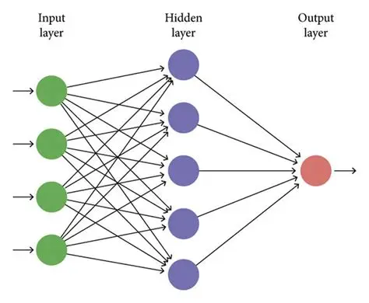
HIDDEN LAYERS
If you combine multiple perceptrons together, you can eliminate the binary nature of a perceptron
An input layer, one or more hidden layers, and an output layer make a multi-layer perceptron
Every unit in a layer takes the outputs of the layer before it as its inputs
Each hidden unit picks up each piece of the pattern, and the output layer combines those pieces into an finalized answer
If you have a lot of hidden layers it’s called deep learning
  It’s the same idea, more layers.

Slide 10
HIDDEN LAYERS
Why it works: layer one finds simple things, layer two combines those results, and layer three combines those results further
These complex connections are able to reflect much more complicated decisions than a simple straight line, like with linear regression
  The tradeoff, as always, is that it’s much harder to read and understand compared to linear regression
A decision tree could be read to a patient, but a network of ten thousand weights cannot
  This is a transparency issue
→ Notes Q3 (a) and (b)

Slide 11
CONVOLUTIONAL NETWORKS
Images break all of the rules we’ve discussed because they’re COMPLICATED
  A 200 by 200 color photo is 120,000 numbers on its own
  If you connect those to just 1,000 hidden units and you have 120 million weights to train
But if you try to flatten the image into a list, it throws away which pixels were next to which
A convolutional neural network keeps the grid’s logic and looks at small patches of it instead
One 3 by 3 kernel is nine weights, and it can be reused in multiple positions on the grid

Slide 12
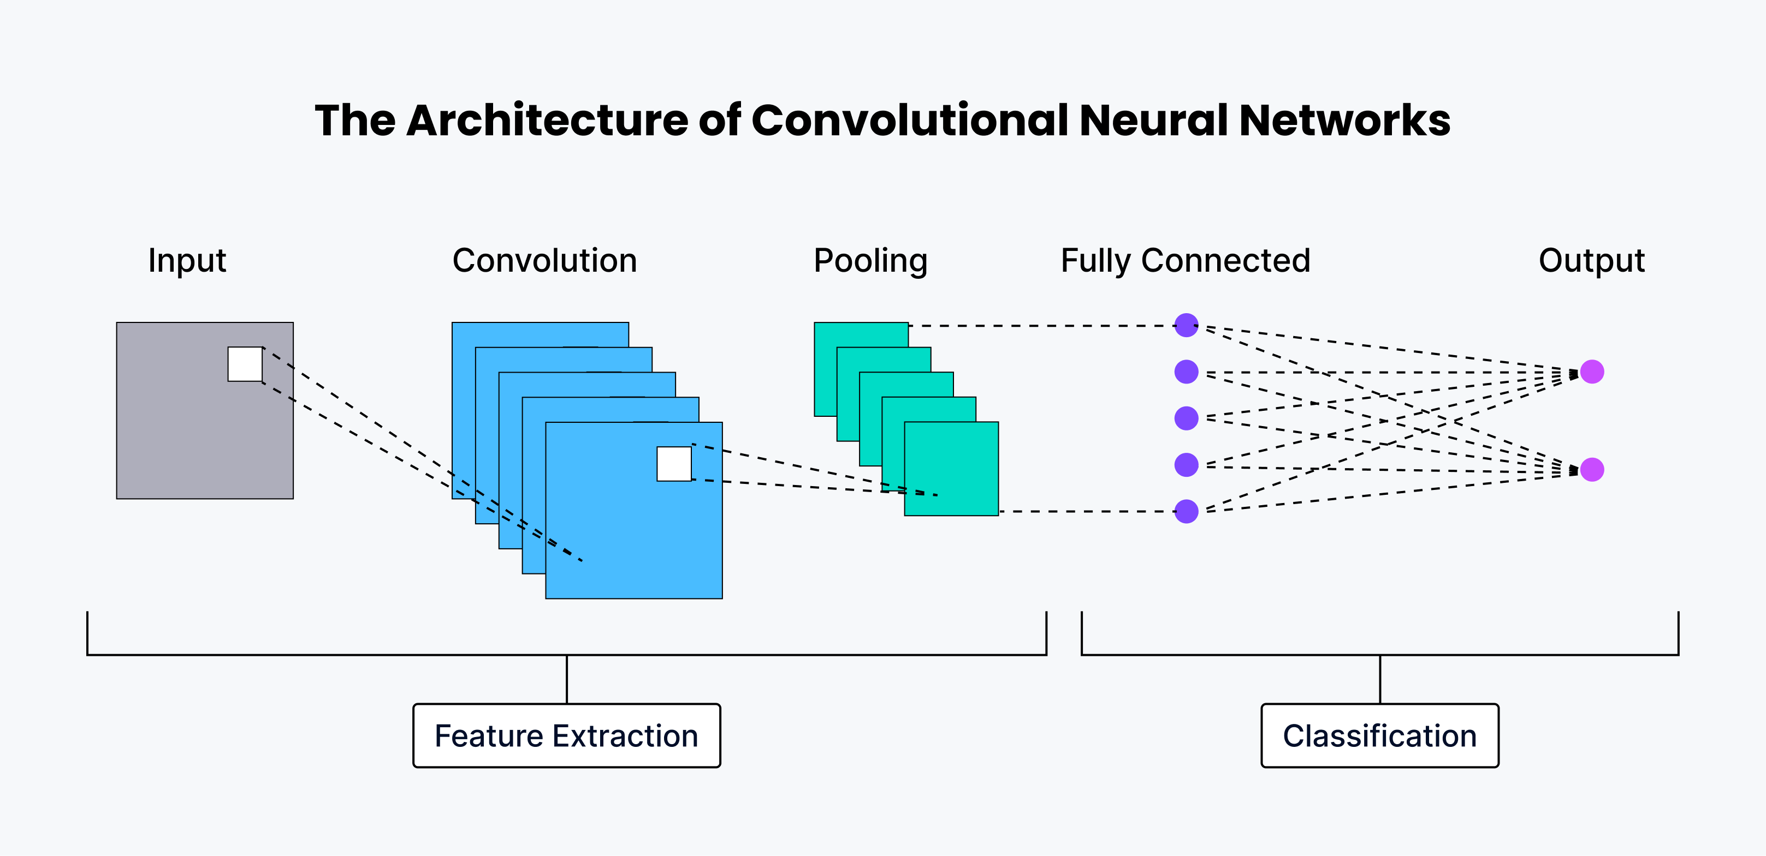
CONVOLUTIONAL NETWORKS

Slide 13
CONVOLUTIONAL NETWORKS
Convolutional networks have six main parts
Input layer - the pixels still arranged as a grid
Convolutional layers - a kernel slides across and produces one number per position
  The grid of results is a feature map
Activation functions - applied after each convolution so the network can model non-linear patterns
Pooling layers - shrink the feature map by keeping the largest value in each small block
Fully connected layers then an output layer - an ordinary MLP (machine learning process) doing the final classifying

Slide 14
CONVOLUTIONAL NETWORKS
Each kernel learns one ‘feature’ by itself
  Oftentimes, the first thing it learns is how to find the edge of an object, noting the color contrast
Early layers find edges and corners of objects
Middle layers combine those into shapes
Late layers combine shapes into objects.
That is the spatial hierarchy
→ Notes Q4 (a), (b) and (c)

Slide 15
THE FOUR SETTINGS
Output size after a convolution = (image width − kernel size) ÷ stride + 1
Stride is how far the kernel jumps each step. Bigger stride, smaller output, faster, less detail
An 8 by 8 image with a 3 by 3 kernel at stride 1 gives 6 by 6.
The same image with a 5 by 5 kernel at stride 1 gives 4 by 4. Bigger kernel, broader features, smaller map
Then 2 by 2 pooling at stride 2 takes that 6 by 6 down to 3 by 3
  Some of this is why AI images took so long to get good

Slide 16
THE FOUR SETTINGS
Four choices change what a CNN can do:
Number of layers - more layers find more complex features, cost more time, and overfits more easily
Kernel size - small finds fine detail, large finds broad shape
  Small takes longer also
Activation function - the wrong one and the network stops learning altogether.
Loss function - it defines what counts as a mistake, providing that data to the model, so it helps to optimize the model
→ Notes Q5 (a) and (b)

Slide 17
CHOOSING A MODEL
We’ve talked about 5 algorithms in this topic: regression, k-NN, decision trees, clustering, neural networks
  If you have already done the genetic algorithms worksheet, that technically makes six!
There is no best one
  Model selection is how we refer to picking the right one for a specific problem

Slide 18
CHOOSING A MODEL
What output do you need? A number is regression. A category is classification. Groups are clustering. A sequence of choices is reinforcement learning.
How much data is there? A network on forty rows will memorise them. A tree will not.
Does the decision have to be explainable? Then a tree, even if the network scores higher.

Slide 19
CHOOSING A MODEL
Hardware matters too - a neural network needs the GPUs from A4-2 and a tree doesn’t at any point really
To compare two models honestly, test both on the same data on the same metrics, then you’ll be able to find what the best one for a specific problem is
  DO NOT CHANGE HOW YOU MEASURE BASED ON THE TYPE OF MODEL
    IT WILL NOT BE COMPARABLE
→ Notes Q6 (a) and (b)

Slide 20
LAB
→ Notes Q7
Q7 (a) A hospital wants to flag tumours in scan images. Identify the type of network and justify your choice. [3]
Q7 (b) Describe how the early, middle and late layers of that network may differ in what they detect. [3]
Notes:
(b) is the spatial hierarchy wording. They need all three levels for full marks.

Slide 21
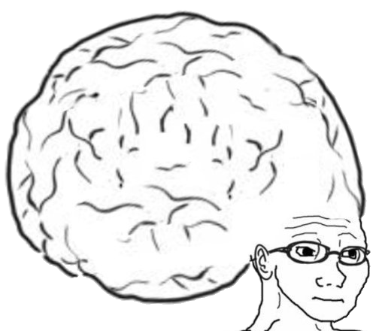
VOCABULARY TO REMEMBER
Artificial neural network
Perceptron
Weight
Bias
Activation function
Hidden layer
Multi-layer perceptron
Deep learning
Spatial hierarchy
Convolutional neural network
Convolutional layer
Kernel
Feature map
Pooling layer
Fully connected layer
Stride
Loss function
Model selection

